Slide 1
6
TECHNIQUES OF INTEGRATION

Slide 2
6.6
Improper Integrals

Slide 3
TECHNIQUES OF INTEGRATION
In defining a definite integral , we dealt with a function f defined on a finite interval [a, b] and we assumed that f does not have an infinite discontinuity in [a, b]. In either case the integral is called an improper integral.

Slide 4
TYPE 1—INFINITE INTERVALS
Consider the infinite region S that lies:
Under the curve y = 1/x²
Above the x-axis
To the right of the line x = 1
You might think that, since S is infinite in extent, its area must be infinite.
However, let’s take a closer look.

Slide 5
INFINITE INTERVALS
The area of the part of S that lies to the left of the line x = t (shaded) is:
Notice that A(t) < 1 no matter how large t is chosen.

Slide 6
INFINITE INTERVALS
We also observe that:
The area of the shaded region approaches 1 as t → ∞.
So, we say that the area of the infinite region S is equal to 1 and we write:

Slide 7
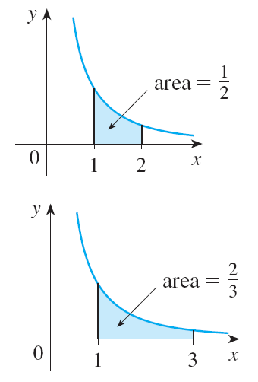
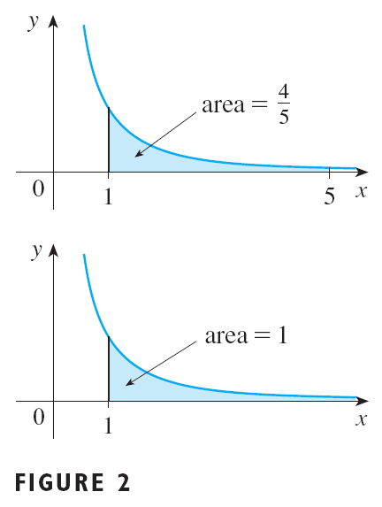
INFINITE INTERVALS

Slide 8
INFINITE INTERVALS
Using this example as a guide, we define the integral of f (not necessarily a positive function) over an infinite interval as the limit of integrals over finite intervals.

Slide 9
DEFINITION OF AN IMPROPER INTEGRAL OF TYPE 1
(a)If exists for every number t ≥ a, then
provided this limit exists (as a finite number).
(b)If exists for every number t ≤ a, then
provided this limit exists (as a finite number).
The improper integrals and are called convergent if the corresponding limit exists and divergent if the limit does not exist.

Slide 10
DEFINITION OF AN IMPROPER INTEGRAL OF TYPE 1
(c) If both and are convergent, then we define: Here, any real number a can be used.

Slide 11
IMPROPER INTEGRALS OF TYPE 1
Any of the improper integrals in Definition 1 can be interpreted as an area provided f is a positive function.

Slide 12
IMPROPER INTEGRALS OF TYPE 1
For instance, in case (a), suppose f(x) ≥ 0 and the integral
is convergent.
Then, we define the area of the region S = {(x, y) | x ≥ a, 0 ≤ y ≤ f(x)} in Figure 3 as:

Slide 13
IMPROPER INTEGRALS OF TYPE 1
This is appropriate because is the limit as t → ∞ of the area under the graph of f from a to t.

Slide 14
Example 1
Determine whether the integral is convergent or divergent.

Slide 15
Example 1 SOLUTION
According to Definition 1(a), we have:
The limit does not exist as a finite number.
So, the integral is divergent.

Slide 16
IMPROPER INTEGRALS OF TYPE 1
Let’s compare the result of Example 1 with the example at the beginning of the section:
Geometrically, this means the following.

Slide 17
IMPROPER INTEGRALS OF TYPE 1
The curves y = 1/x² and y = 1/x look very similar for x > 0.
However, the region under y = 1/x² to the right of x = 1 has finite area, but the corresponding region under y = 1/x has infinite area.

Slide 18
IMPROPER INTEGRALS OF TYPE 1
Note that both 1/x² and 1/x approach 0 as x → ∞, but 1/x² approaches faster than 1/x.
The values of 1/x don’t decrease fast enough for its integral to have a finite value.

Slide 19
Example 2
Evaluate
SOLUTION
Using Definition 1(b), we have:
We integrate by parts with u = x, dv = e^{x} dx so that du = dx, v = e^{x}:

Slide 20
Example 2 SOLUTION
We know that e^{t} → 0 as t → –∞, and, by l’Hospital’s Rule, we have:
Therefore,

Slide 21
Example 3
Evaluate
SOLUTION
It’s convenient to choose a = 0 in Definition 1(c):
We must now evaluate the integrals on the right side separately—as follows.

Slide 22
Example 3 SOLUTION

Slide 23
Example 3 SOLUTION
Since both these integrals are convergent, the given integral is convergent and

Slide 24
Example 3 SOLUTION
As 1/(1 + x²) > 0, the given improper integral can be interpreted as the area of the infinite region that lies under the curve y = 1/(1 + x²) and above the x-axis.

Slide 25
Example 4
For what values of p is the integral convergent?
SOLUTION
We know from Example 1 that, if p = 1, the integral is divergent.
So, let’s assume that p ≠ 1.

Slide 26
Example 4 SOLUTION
Then,

Slide 27
Example 4 SOLUTION
If p > 1, then p – 1 > 0.
So, as t → ∞, t^{p–1} → ∞ and 1/t^{p–1} → 0.
Therefore,
So, the integral converges.
However, if p <1, then p – 1 < 0.
So,
Thus, the integral diverges.

Slide 28
Definition 2
We summarize the result of Example 4 for future reference:
is convergent if p > 1 and divergent if p ≤ 1.

Slide 29
TYPE 2: DISCONTINUOUS INTEGRANDS
Suppose f is a positive continuous function defined on a finite interval [a, b) but has a vertical asymptote at b.
Let S be the unbounded region under the graph of f and above the x-axis between a and b.
For Type 1 integrals, the regions extended indefinitely in a horizontal direction.
Here, the region is infinite in a vertical direction.

Slide 30
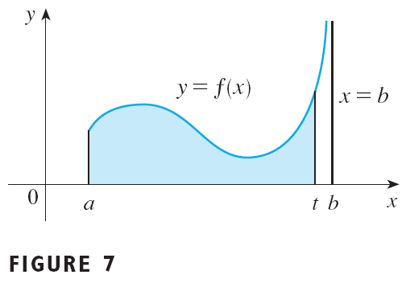
DISCONTINUOUS INTEGRANDS
The area of the part of S between a and t (shaded region) is:

Slide 31
DISCONTINUOUS INTEGRANDS
If it happens that A(t) approaches a definite number A as t → b–, then we say that the area of the region S is A and we write:
We use the equation to define an improper integral of Type 2 even when f is not a positive function—no matter what type of discontinuity f has at b.

Slide 32
DEFINITION OF AN IMPROPER INTEGRAL OF TYPE 2
(a)If f is continuous on [a, b) and is discontinuous at b, then if this limit exists (as a finite number).
(b)If f is continuous on (a, b] and is discontinuous at a, then if this limit exists (as a finite number). The improper integral is called convergent if the corresponding limit exists and divergent if the limit does not exist.

Slide 33
DEFINITION OF AN IMPROPER INTEGRAL OF TYPE 2
(c)If f has a discontinuity at c, where a < c < b, and both and are convergent, then we define:

Slide 34
DEFINITION OF AN IMPROPER INTEGRAL OF TYPE 2
Definition 3(b) is illustrated in Figure 8 for the case where f(x) ≥ 0 and has vertical asymptotes at a and c, respectively.

Slide 35
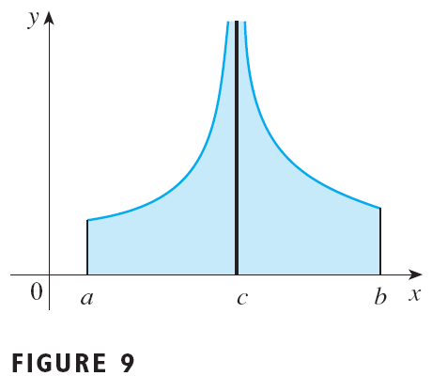
DEFINITION OF AN IMPROPER INTEGRAL OF TYPE 2
Definition 3(c) is illustrated for the case where f(x) ≥ 0 and has vertical asymptotes at a and c, respectively.

Slide 36
Example 5
Find
SOLUTION
First, we note that the given integral is improper because
has the vertical asymptote x = 2.

Slide 37
Example 5 SOLUTION
The infinite discontinuity occurs at the left end-point of [2, 5].
So, we use Definition 3(b):
Thus, the given improper integral is convergent.

Slide 38
Example 5 SOLUTION
Since the integrand is positive, we can interpret the value of the integral as the area of the shaded region here.

Slide 39
Example 6
Determine whether converges or diverges.
SOLUTION
Note that the given integral is improper because:

Slide 40
Example 6 SOLUTION
Using Definition 2 a and Formula 14 from the Table of Integrals, we have:
This is because sec t → ∞ and tan t → ∞ as t → (π/2)–.
Thus, the given improper integral is divergent.

Slide 41
Example 7
Evaluate if possible.
SOLUTION
Observe that the line x = 1 is a vertical asymptote of the integrand.

Slide 42
Example 7 SOLUTION
As it occurs in the middle of the interval [0, 3], we must use Definition 3 c with c = 1: where
This is because 1 – t → 0⁺ as t → 1–.

Slide 43
Example 7 SOLUTION
Thus, is divergent.
This implies that is divergent.
We do not need to evaluate

Slide 44
WARNING
Suppose we had not noticed the asymptote x = 7 in Example 7 and had, instead, confused the integral with an ordinary integral.
Then, we might have made the following erroneous calculation:
This is wrong because the integral is improper and must be calculated in terms of limits.

Slide 45
WARNING
From now, whenever you meet the symbol , you must decide, by looking at the function f on [a, b], whether it is either:
An ordinary definite integral
An improper integral

Slide 46
A COMPARISON TEST FOR IMPROPER INTEGRALS
Sometimes, it is impossible to find the exact value of an improper integral and yet it is important to know whether it is convergent or divergent.
In such cases, the following theorem is useful.
Although we state it for Type 1 integrals, a similar theorem is true for Type 2 integrals.

Slide 47
COMPARISON THEOREM
Suppose f and g are continuous functions with
f(x) ≥ g(x) ≥ 0 for x ≥ a.
(a)If is convergent, then is convergent.
(b)If is divergent, then is divergent.

Slide 48
COMPARISON THEOREM
We omit the proof of the Comparison Theorem, but Figure 11 makes it seem plausible.

Slide 49
COMPARISON THEOREM
If the area under the top curve y = f(x) is finite, so is the area under the bottom curve y = g(x).
If the area under y = g(x) is infinite, so is the area under y = f(x).

Slide 50
COMPARISON THEOREM
Note that the reverse is not necessarily true:
If is convergent, may or may not be convergent.
If is divergent, may or may not be divergent.

Slide 51
Example 8
Show that is convergent.
SOLUTION
We can’t evaluate the integral directly.
The antiderivative of e^{–x2} is not an elementary function (as explained in Section 6.4).
We write:
We observe that the first integral on the right-hand side is just an ordinary definite integral.

Slide 52
Example 8 SOLUTION
In the second integral, we use the fact that, for x ≥ 1, we have x² ≥ x.
So, – x² ≤ – x and, therefore, e^{–x2} ≤ e^{–x}.
See Figure 12.

Slide 53
Example 8 SOLUTION
The integral of e^{–x} is easy to evaluate:
Thus, taking f(x) = e^{-x} and g(x) = e^{-x2} in the theorem, we see that is convergent.
It follows that is convergent.

Slide 54
COMPARISON THEOREM
In Example 8, we showed that is convergent without computing its value.
In Exercise 70, we indicate how to show that its value is approximately 0.8862.
In probability theory, it is important to know the exact value of this improper integral.
Using the methods of multivariable calculus, it can be shown that the exact value is

Slide 55
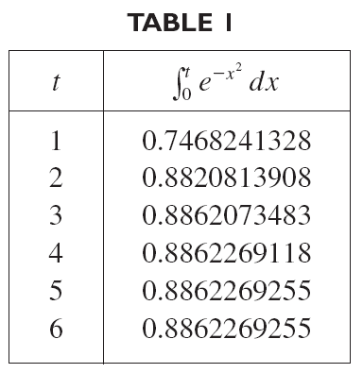
COMPARISON THEOREM
Table 1n illustrates the definition of an improper integral by showing how the (computer-generated) values of approach as t becomes large.
In fact, these values converge quite quickly because e^{–x2} → 0 very rapidly as x → ∞.

Slide 56
Example 9
The integral is divergent by the Comparison Theorem since and is divergent by Example 1 [or by Definition 2 with p = 1].

Slide 57
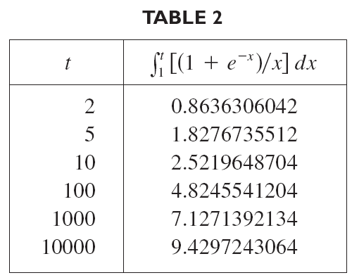
COMPARISON THEOREM
Table 2 illustrates the divergence of the integral in Example 9.
It appears the values are not approaching any fixed number.

